Slide 1

Applied Cloud Computing
Slides adapted from:
J. Leskovec, A. Rajaraman, J. Ullman: Mining of Massive Datasets, http://www.mmds.org

Slide 2
Objectives
Understand the theory behind different distributed computing frameworks
Use distributed computing tools to process, clean and apply machine learning to massive datasets
Apply the correct solutions to massive datasets to improve computational efficiency
Build data extraction and processing pipelines for streaming data
Become acquainted with cutting edge big data tools

Slide 3
Administrative Stuff
Zoom: https://drexel.zoom.us/j/529562000
Office Hours – by appointment

Slide 4
Resources
http://www.mmds.org/#book
I heart Logs by Jay Kreps
We will also read research papers and book chapters throughout the quarter

Slide 5
Course Software
This course will be taught entirely in Python
You will receive credits for Google Cloud
Assignments can be done in Google Cloud and submitted as Python scripts or on Colab and submitted as notebooks.

Slide 6
Assignments
The final grade will be comprised of:
HW Assignments – 40%
Midterm – 20%
Final Project – 40%

Slide 7
What Will We Learn?
Introduction and MapReduce
Apache Spark
RDDs
DataFrames
MLLib
Spark Streaming
Recommender Systems
Similarity at scale – Locality Sensitive Hashing
Apache Flink
Apache Arrow
Presto

Slide 8
“Big” Data
3 V’s
Velocity – large datasets from a variety of sources that may require distributed storage
Volume – may be a high rate stream like sensors, social media, transaction data
Variety – comes from multiple sources like images, text, unstructured, etc.
There is no clear size threshold, but as a rule of thumb, big data requires distributed computing and distributed storage

Slide 9
Why cloud computing for distributed storage and processing?
Storing and processing data locally is unmanageable or too costly
Reducing Storage and maintenance costs
Using only the resources we need
Notes:
In the past, we used to store data in large servers, but some algorithms require in memory computations. Over time, we cannot keep scaling our machines up, we need to scale them out. The cost of doing this locally becomes too large
Updating our machines to the latest technology is also very costly. Using cloud computing allows us to have the most up to date hardware and software. We also don’t need to employ a large IT team to maintain our machines.
We can also only use the resources we need at any moment. We can scale up and down within moments. If we were to purchase our own resources, we might be stuck with a lot of extra machines throughout the year for only one major event.

Slide 10
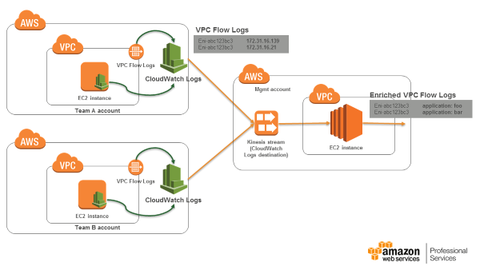

Examples
Netflix uses AWS to process their traffic flows (source)
Spotify uses Google Cloud (source)

Slide 11
Cloud Computing
Distributed file systems
MapReduce

Slide 12
Scaling Vertically vs. Horizontally
Vertical scaling entails resizing your machine to enable you to process your data
Horizontal scaling means adding more machines and distributing your data between them for processing

Slide 13
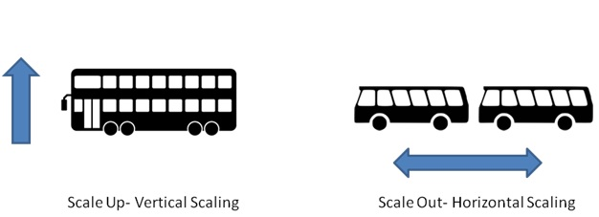
Scaling Vertically vs. Horizontally
Vertical scaling is simpler since we do not have to coordinate between multiple machines; however, there is a limit to how large we can scale a single machine
In the world of big data, we tend to work in distributed systems and scale out

Slide 14
Distributed File Systems
Our files reside in multiple machines
Storing our files in multiple machines solves one problem but creates others, particularly failure
For example, a server may stay up for about 3 years (1000 days)
However, if you have 1M servers, this means an average loss of 1000 servers a day!
Additionally, transferring files between machines is time consuming

Slide 15
Distributed File Systems
How do we solve these problems?
Machine failures could cause loss of files
To avoid these losses, we must have redundant storage
We also subdivide tasks so that if a machine was lost during a subtask, we can reassign the subtask to a different machine and also not lose the entire computation
To reduce the impact of file transfer, we bring our computations close to the data

Slide 16

Types of Distributed File Systems
GFS – developed by Google
HDFS (Hadoop Distributed File System) – Open Source

Slide 17
Distributed File System Components
Chunk Servers
File is split into contiguous chunks
Typically each chunk is 16-64MB
Each chunk replicated (usually 2x or 3x)
Try to keep replicas in different racks

Slide 18
Distributed File System Components
The Master Node
Also known as the Name Node in Hadoop’s HDFS
Stores metadata about where files are stored
Might be replicated
Client library for file access
Talks to master to find chunk servers
Connects directly to chunk servers to access data

Slide 19
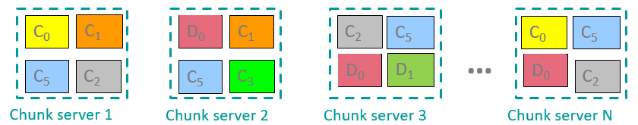
Chunk Servers
Data kept in “chunks” spread across machines
Each chunk replicated on different machines

Slide 20
The MapReduce Programming Model
The mapreduce programming model is meant for processing data where are files are too large to fit into memory
The name comes from the two main steps in this process – mapping and reducing

Slide 21
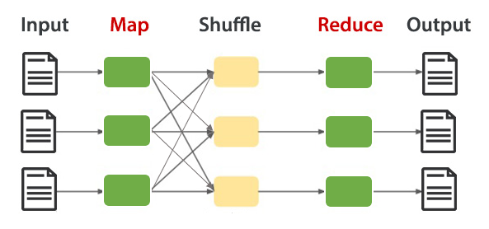
The MapReduce Programming Model
A MapReduce program has three main steps:
Map
Shuffle
Reduce

Slide 22
Mapping
The first step in the process is to divide our data into pieces and apply a function to every chunk using the map function
This allows us to parallelize the operation over multiple machines
Our data is processed as key value pairs
Notes:
A key is attached to each chunk

Slide 23
Shuffling
During this step we shuffle the data and sort the data by keys
This will produce the input for the reduce step where our key value pairs are grouped by key

Slide 24
Reducing
The reducing step receives the key value pairs after a function has been applied to them
All values with the same key are reduced together

Slide 25
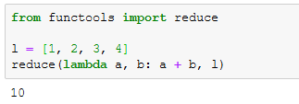
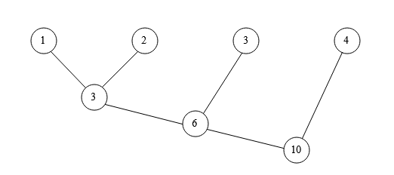
Reducing
A reduce function combines two elements at a time
Example – sum using reduce

Slide 26
Example – Word Count
the wheels on the bus go round and round
Words
(the)
(wheels)
(on)
(the)
(bus)
(go)
(round)
(and)
(round)

Slide 27
Example – Word Count
the wheels on the bus go round and round
Words Map
(the) (the, 1)
(wheels) (wheels, 1)
(on) (on, 1)
(the) (the, 1)
(bus) (bus, 1)
(go) (go, 1)
(round) (round, 1)
(and) (and, 1)
(round) (round, 1)

Slide 28
Example – Word Count
the wheels on the bus go round and round
Words Map Shuffle
(the) (the, 1)
(wheels) (wheels, 1) (the, [1,1])
(on) (on, 1) (wheels, [1])
(the) (the, 1) (on, [1])
(bus) (bus, 1) (bus, [1])
(go) (go, 1) (go, [1])
(round) (round, 1) (round, [1,1])
(and) (and, 1) (and, [1])
(round) (round, 1)

Slide 29
Example – Word Count
the wheels on the bus go round and round
Words Map Shuffle Reduce
(the) (the, 1)
(wheels) (wheels, 1) (the, [1,1]) (the, 2)
(on) (on, 1) (wheels, [1]) (wheels, 1)
(the) (the, 1) (on, [1]) (on, 1)
(bus) (bus, 1) (bus, [1]) (bus, 1)
(go) (go, 1) (go, [1]) (go, 1)
(round) (round, 1) (round, [1,1]) (round, 2)
(and) (and, 1) (and, [1]) (and, 1)
(round) (round, 1)

